Slide 1
NYC Flights

Slide 2
Introduction
Commercial aviation accounts for over 5% of annual GDP in The United States
Operation of over 26,000 flights both foreign and domestic, carrying 2.6 million passengers daily
Responsible for over 10,000,000 American jobs
JFK ranks 6th at 26.9 million passengers annually
EWR ranks 13th at 21.6 million passengers annually
LGA ranks 19th at 14.4 million passengers annually

Slide 3
Background
Most popular use cases being flight delay prediction
More than 20% of commercial flights experience an arrival delay of over 15 minutes
Leading to both logistic and economic challenges for airlines and passengers alike

Slide 4
Previous Studies
“Airline delay prediction by machine learning algorithms” used decision tree, cluster classification, and random forest to examine flight delays between US and Iranian airways. The study concluded that the most significant variables contributing to flight delay times are visibility, wind, and departure time.
“Machine learning approach for flight departure delay prediction and analysis” utilized support vector machines to investigate patterns of delays at the three major New York airports. The study concluded that the most influential contributing factors to arrival delay include pushback delay, traffic volume, and weather.
“Machine learning techniques for analysis of Egyptian flight delay” employed a variety of different decision trees to classify flight delays in Egyptian Airlines flight data. The accuracy of each model was compared with the highest accuracy percentage for a decision tree built being 83%.

Slide 5
The Data
R library nycflights13
Built upon a database schema
Flights table contains flights of over 4,000 commercial aircraft flying to 105 unique destinations both foreign and domestic
Weather table includes Automated Weather Observation System (AWOS) data by the hour at each airport
The inner_join() function was use to concatenate the flights and weather table.The data frame constructed contains 336,776 total observations and 29 variables
Each observation represents a flight departing from one of the three airports mentioned

Slide 6
Libraries Used

Slide 7
Variables
Year: Integer, being nycflights13 all observations are recorded as 2013
Month: Integer, 1 signifies January and so on to 12 for December. This will be converted to a factor as month should be treated as a categorical variable for this analysis
Day: Integer, day of the month that the recorded flight departed
Dep_time: Integer, departure time of flight recorded in 24-hour standard time
Sched_dep_time: Integer, scheduled departure time of flight recorded in 24-hour standard time
Dep_delay: Double precision, difference between scheduled departure time and actual departure time, positive value signifies a departure delay while a negative value signifies the flight left early
Arr_time: Integer, arrival time of flight recorded in 24-hour standard time
Sched_arr_time: Integer, scheduled arrival time of flight recorded in 24-hour standard time
Arr_delay: Double precision, difference between scheduled arrival time and actual arrival time, positive value signifies an arrival delay while a negative value signifies the flight arrived early
Carrier: Character, two letter abbreviation for the airline conducting the flight
Flight: Integer, three or four digit code that signifies the flight number
Tailnum: Character, the tail number of the aircraft that conducted the flight
Origin: Character, ICAO code for departure airport
Dest: Character, ICAO code for arrival airport
Air_time: Double precision, time in minutes between departure and arrival

Slide 8
Variables Continued
Distance: Double precision, distance between departure and arrival airport in statute miles
Hour: Double precision, hour of scheduled departure time in 24-hour standard time
Minute: Double precision, minute of scheduled departure time in 24-hour standard time
Time_hour: Date-time, date and hour of scheduled departure
20) Made: Integer, amount of time a flight makes up over estimated time in the air. The formula for deriving “Made” was departure delay - arrival delay. A negative value indicates the flight lost time in the air, while a positive value indicates the flight made up time
21) Temp: Numeric, ambient air temperature in degrees Fahrenheit at time of departure
22) Dewp: Numeric, dew point at time of departure
23) Humid: Numeric, humidity at time of departure
24) Wind_dir: Integer, wind direction as a heading fix at time of departure
25) Wind_speed: Numeric, wind speed in statute miles per hour at time of departure
26) Wind_gust: Numeric, wind gusts in statute mile per hour at time of departure
27) Precip: Numeric, precipitation rate per hour in inches at time of departure
28) Pressure: Numeric, ambient air pressure in millibars at time of departure
29) Visib: Integer, visibility in statute miles at time of departure

Slide 9
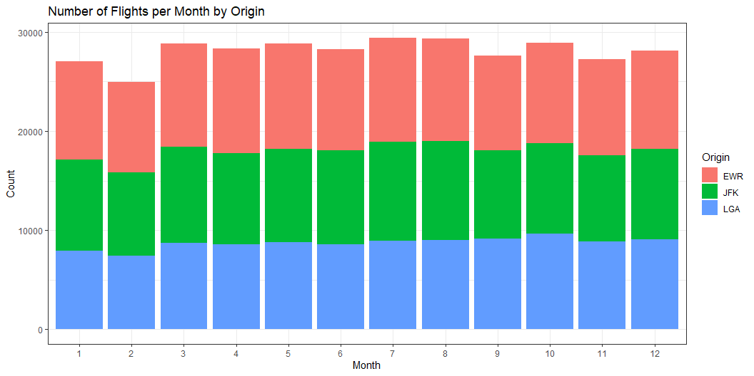
Number of Flights per Month by Origin

Slide 10
as.factor(month) origin 1 2 3 4 5 6 7 8 9 10 11 12 EWR 9893 9107 10420 10531 10592 10175 10475 10359 9550 10104 9707 9922 JFK 9161 8421 9697 9218 9397 9472 10023 9983 8908 9143 8710 9146 LGA 7950 7423 8717 8581 8807 8596 8927 8985 9116 9642 8851 9067

Slide 11
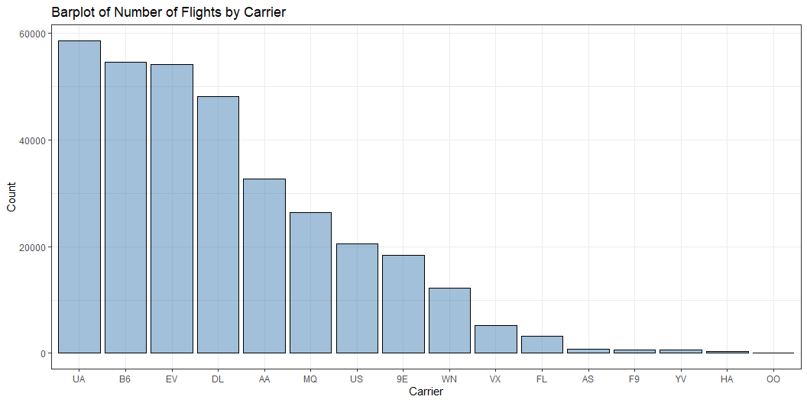
Number of Flights by Carrier

Slide 12
carrier 9E AA AS B6 DL EV F9 FL HA MQ OO UA US 18460 32729 714 54635 48110 54173 685 3260 342 26397 32 58665 20536 VX WN YV 5162 12275 601

Slide 13
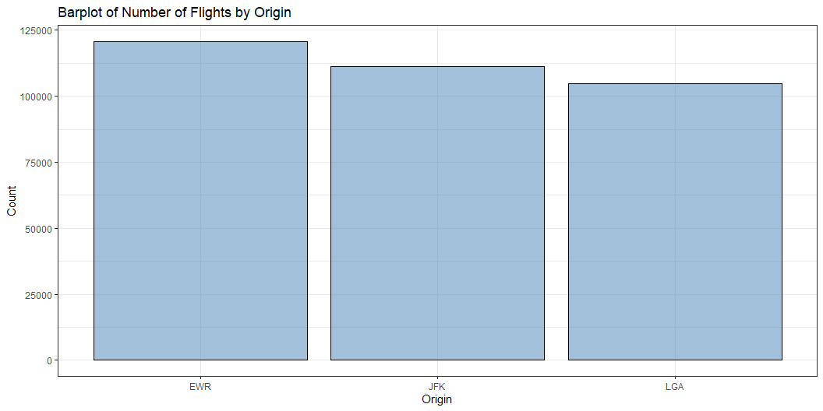
Number of Flights by Origin

Slide 14
origin EWR JFK LGA 120835 111279 104662

Slide 15
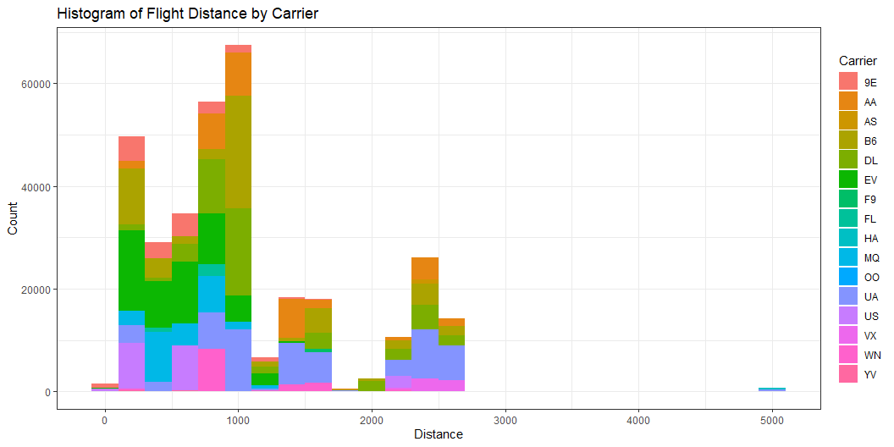
Histogram of Flight Distance by Carrier

Slide 16
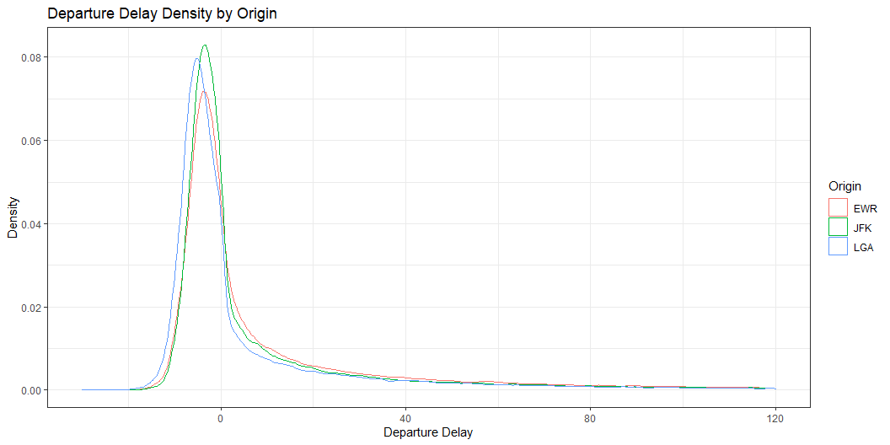
Departure Delay Density by Origin

Slide 17
flights$origin: EWR Min. 1st Qu. Median Mean 3rd Qu. Max. NA's -25.00 -4.00 -1.00 15.11 15.00 1126.00 3239 ------------------------------------------------------------ flights$origin: JFK Min. 1st Qu. Median Mean 3rd Qu. Max. NA's -43.00 -5.00 -1.00 12.11 10.00 1301.00 1863 ------------------------------------------------------------ flights$origin: LGA Min. 1st Qu. Median Mean 3rd Qu. Max. NA's -33.00 -6.00 -3.00 10.35 7.00 911.00 3153

Slide 18
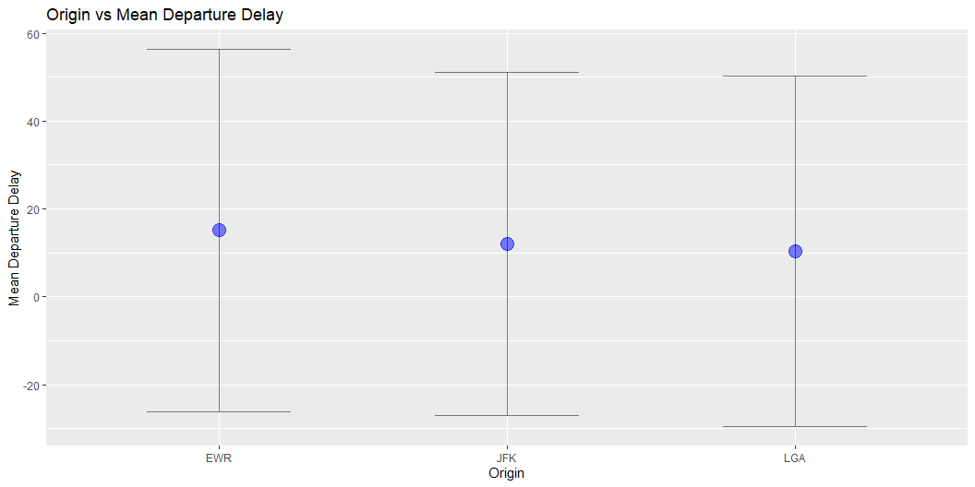
Origin vs Mean Departure Delay

Slide 19
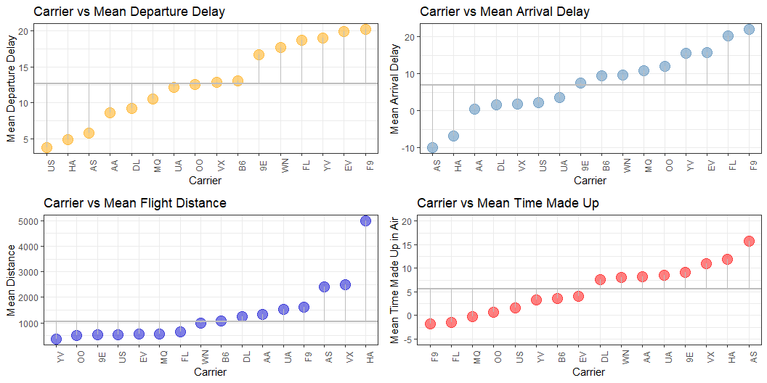
Lollipop Graphs

Slide 20
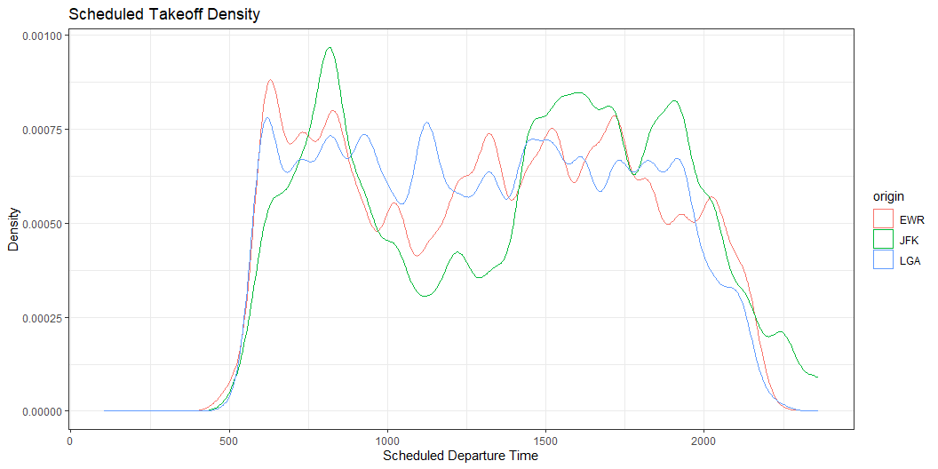
Scheduled Takeoff Density by Origin

Slide 21
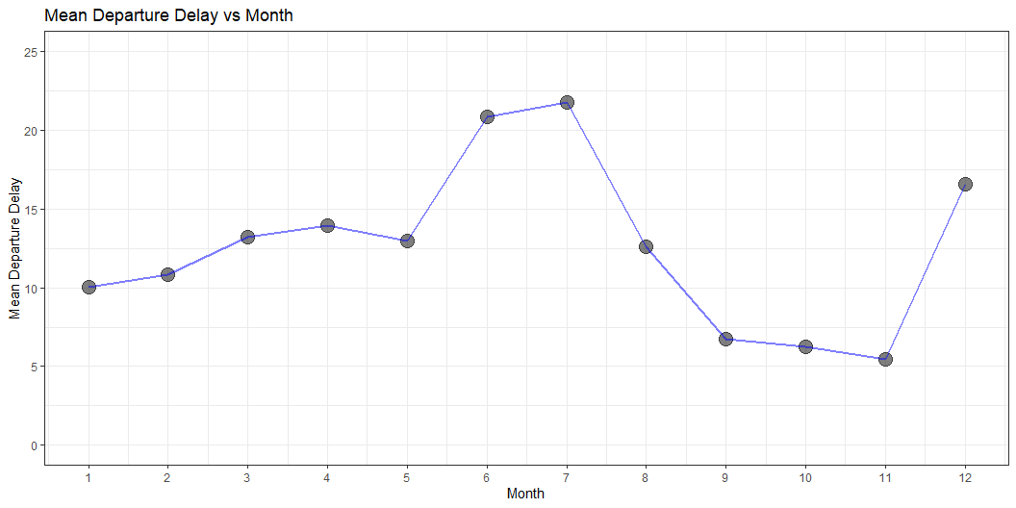
Mean Departure Delay vs Month

Slide 22
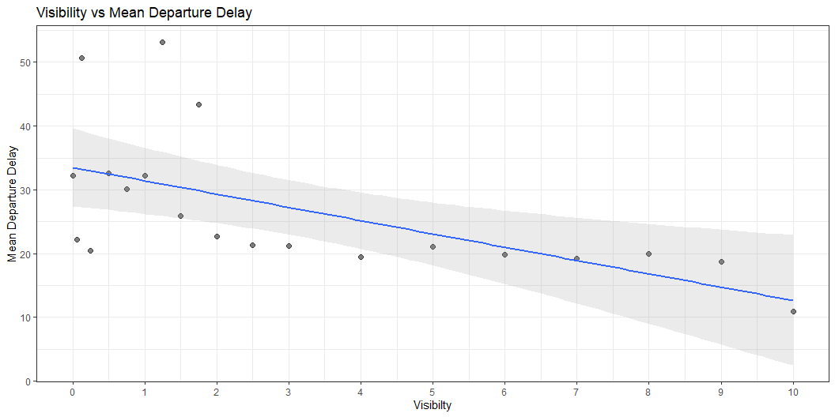
Mean Departure Delay vs Visibility

Slide 23
Logistic Regression
Binary Classifier
Logistic or Sigmoid Function
Output probability between 0 and 1 is used to classify observations
Optimal cutoff
Standard 70/30 split for train and test set

Slide 24
Logistic Regression Application
Classify observations based on a derived variable of significant arrival delay
Denoted as sig_arr_delay is a binary factor with a 1 corresponding to a flight arriving at its destination greater than 7 minutes late, and a 0 corresponds to a flight being less than 7 minutes late
The mean arrival delay for all observations is 6.88 minutes

Slide 25
Model Summary
Call: glm(formula = sig_arr_delay ~ air_time + made + dep_time + distance + wind_speed + visib, family = "binomial", data = Train) Deviance Residuals: Min 1Q Median 3Q Max -2.3508 -0.7088 -0.4184 0.5909 4.2693 Coefficients: Estimate Std. Error z value Pr(>|z|) (Intercept) -1.598e+00 3.279e-02 -48.734 < 2e-16 *** air_time -2.158e-03 5.107e-04 -4.226 2.38e-05 *** made -8.733e-02 4.919e-04 -177.527 < 2e-16 *** dep_time 1.452e-03 1.211e-05 119.870 < 2e-16 *** distance 3.277e-04 6.591e-05 4.972 6.63e-07 *** wind_speed 1.331e-02 9.899e-04 13.444 < 2e-16 *** visib -1.163e-01 2.733e-03 -42.540 < 2e-16 *** --- Signif. codes: 0 '***' 0.001 '**' 0.01 '*' 0.05 '.' 0.1 ' ' 1 (Dispersion parameter for binomial family taken to be 1) Null deviance: 282961 on 228016 degrees of freedom Residual deviance: 204546 on 228010 degrees of freedom (56 observations deleted due to missingness) AIC: 204560 Number of Fisher Scoring iterations: 5
[1] 0.2771216
[1] 0

Slide 26
Optimal Cutoff and Confusion Matrix
threshold 1 0.3578069
labels sig 6 1 1 14 0 0 15 1 1 25 0 0 30 0 0 37 0 0
labels 0 1 0 55185 9599 1 12134 20806
FALSE TRUE 0.2223416 0.7774333

Slide 27
Sensitivity and Specificity Rates
[1] 0.8184465
[1] 0.6860056
[1] 0.22276
Sensitivity or true positive rate near 82%
Specificity or true negative rate near 69%
Mis-classification rate near 22%

Slide 28
K-Means Clustering
K-means clustering is an unsupervised machine learning algorithm used for partitioning a dataset into distinct clusters based on similarity
Each observation belongs to the cluster with the nearest centroid
The algorithm iteratively assigns observations to the nearest centroid and updates the centroids based on the mean of the assigned observations
Minimizing the within-cluster sum of squares, seeking to minimize the variance within clusters and maximize the variance between clusters
Numeric data subset for distance based algorithm

Slide 29
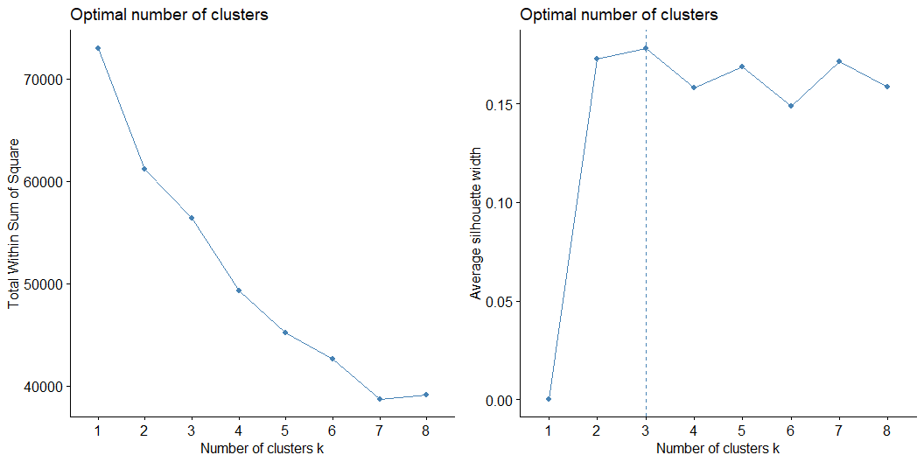
Optimal Number of Clusters

Slide 30
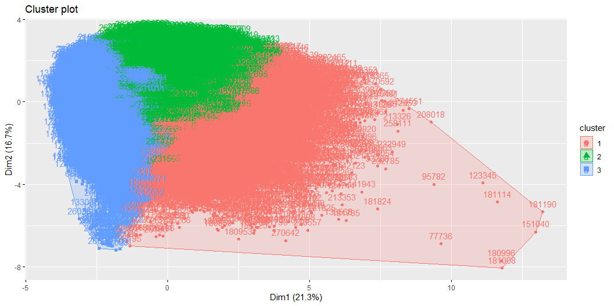
Cluster Visualization

Slide 31
Cluster Means
cluster dep_time sched_dep_time dep_delay arr_time arr_delay air_time 1 1 1728.1583 1664.4999 49.5615363 1770.018 52.992147 148.6251 2 2 1583.0332 1577.2936 4.8835732 1784.105 -3.618387 149.9497 3 3 945.0491 955.3652 0.4918396 1174.504 -4.369293 148.4178 distance made temp wind_dir wind_speed wind_gust visib cluster 1 997.7457 -3.430610 47.50902 252.3158 20.79241 30.02147 9.149586 1 2 1047.6204 8.501960 62.13778 246.6134 14.35711 22.35741 9.922029 2 3 1010.7296 4.861132 45.78576 253.8420 17.28911 25.71672 9.624746 3

Slide 32
Observation Arrangements
Flights with late departure times assigned to cluster 1
Flights with early departure times are assigned to a mixed bag of either cluster 1 or 3
Flights with the greatest departure delay are all assigned to cluster 1
Flights with the smallest departure delay (left early) are assigned to a mixed number of clusters

Slide 33
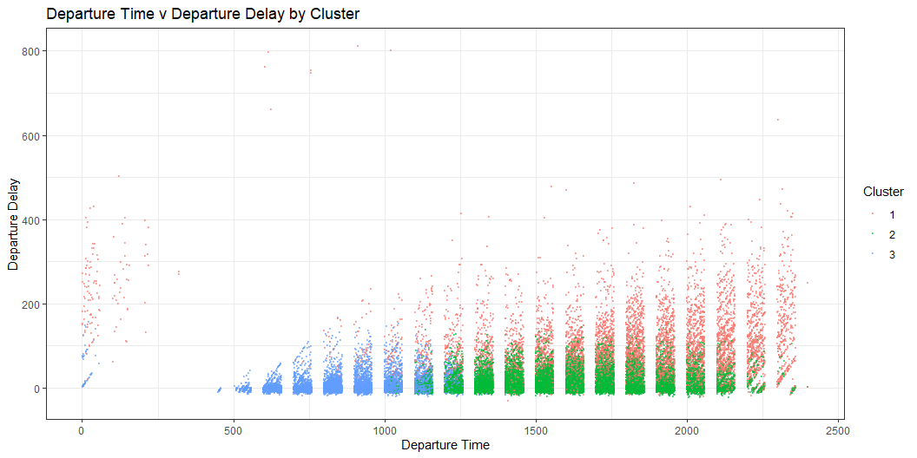
Observation Arrangements Visualization

Slide 34
Logistic Model Results
Accuracy in classifying binary outcome near 80%
Log odds

Slide 35
K-Means Results
Lack of variance retained from the original numeric data set in dimensionality reduction
Principal Component Analysis is used to reduce the input data to two dimensions, making it suitable for the distance based K-Means algorithm
Dimension 1 accounted for 21.3% of variance in the original data set and dimension 2 accounted for 16.7% of variance in the original data set, summing to 38%
Cluster Means

Slide 36
Logistic Model Use Cases
Logistic regression model built to classify significant arrival delay include but are not limited to, flight scheduling, arrival predictions, traffic management, and operation logistics planning
The model could be integrated into airport capacity planning systems to optimize resource allocation and mitigate congestion during peak hours
Furthermore, airlines could utilize the model to enhance customer service by proactively managing delays and informing passengers about potential disruptions
Additionally, government agencies responsible for transportation infrastructure could leverage the insights generated by the model to improve overall system efficiency and reliability. Overall, the versatility of the logistic regression model extends beyond solely arrival delay classification

Slide 37
K-Means Model Use Cases
Travel patterns, demand forecasting, and route optimization
For instance, airlines can identify high-demand routes or peak travel times, allowing for more strategic scheduling and resource allocation
Moreover, k-means clustering enables airlines to segment their customer base more effectively, tailoring services and marketing efforts to different traveler preferences
Overall, leveraging logistic regression and k-means clustering in commercial aviation facilitates data-driven decision-making and offers valuable insights for enhancing operational efficiency and customer satisfaction.

